Slide 1
Currency conversion in Mojaloop: Planning meeting

Slide 2
Agenda
New proposal for changes to core
Project roles
Code design
Path to story breakdown

Slide 3
New proposal for changes to core

Slide 4
Background
There were several comments at the last meeting:
Distinguishing conversions by asking whether a participant had an account in a particular currency was unreliable.
The architecture did not make it easy for vNext developers to understand where they would need to make changes.
There were more decisions than necessary before a payment could be identified as not requiring currency conversion and routed down the single-currency path.
We listened and responded

Slide 5
The watchlist
A component of the “currency conversion bounded context”.
Contains an entry for each component of a payment which includes currency conversion.
Entries are added over the progress of the payment.
Entries are “removed” once the payment is complete.
Data elements (provisional):
The transaction ID of the payment itself
Optionally, the ID of the conversion
An indicator specifying whether the currency conversion has completed or not.

Slide 6
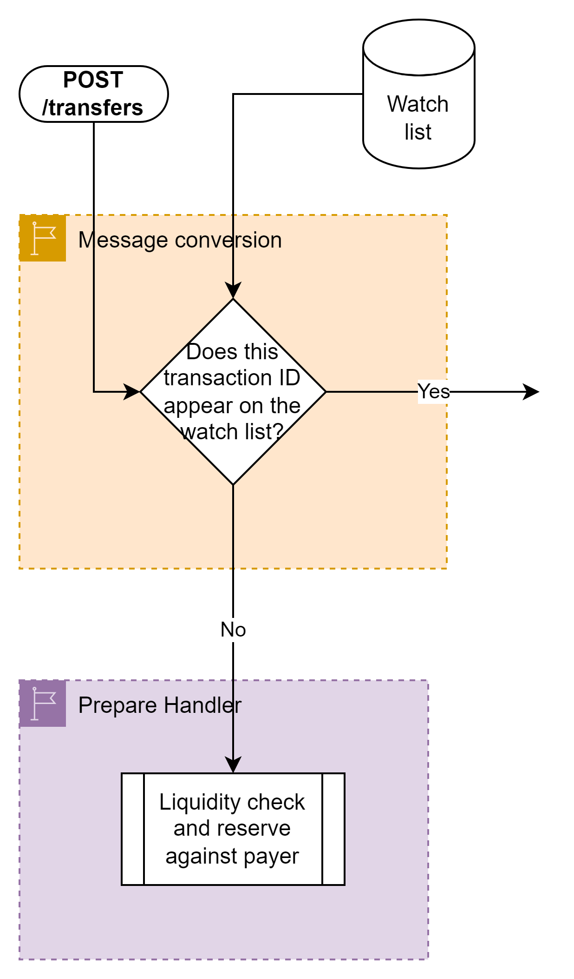
Revised architecture proposal - Prepare (1)
Additions to the existing message conversion process
When a POST /transfers is received, the message conversion process enquires as to whether there are any entries on the watchlist for the transaction ID
If not, the request is routed own the existing route.
Otherwise, the request is routed to FX processing.
There will be no entries if:
The payment does not require currency conversion, or
There is currency conversion, but it has been requested by the creditor.

Slide 7
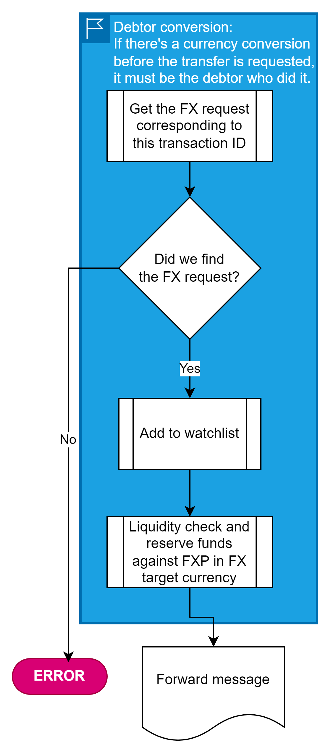
Revised architecture proposal - Prepare (2)
A POST /transfers is issued after a currency conversion has already been processed.
It must therefore have been issued by the debtor DFSP
So this represents the second part of the payment:
We get the FX request via the watchlist entry
The liquidity check should be against the FXP in the FX request.
We add the transaction ID to the watchlist.

Slide 8
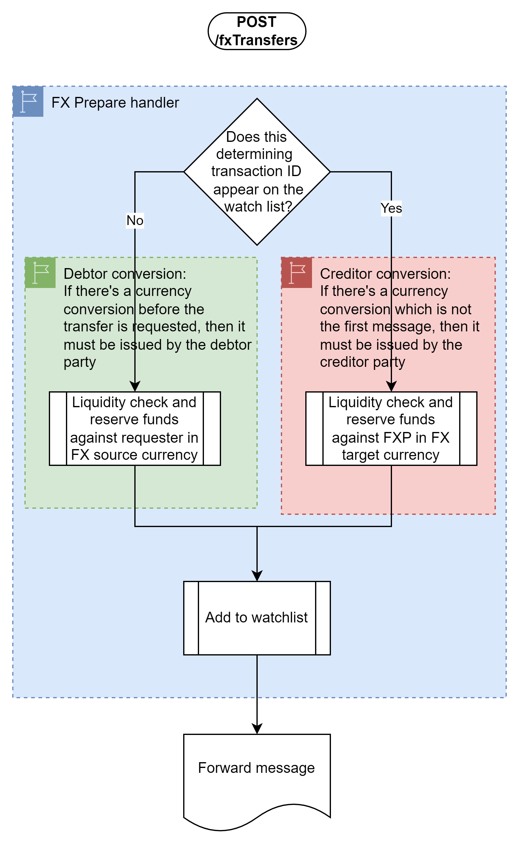
Revised architecture proposal - Prepare (3)
A POST /fxTransfers is received
If there is already an entry on the watchlist:
This is not the first message
So it must have been issued by the creditor party
The liquidity check and funds reservation are against the FXP in the FX target currency
Otherwise:
This is the first message.
So it must have been issued by the debtor party
The liquidity check and funds reservation are against the requester in the FX source currency.
In both cases, add the entry to the watchlist

Slide 9
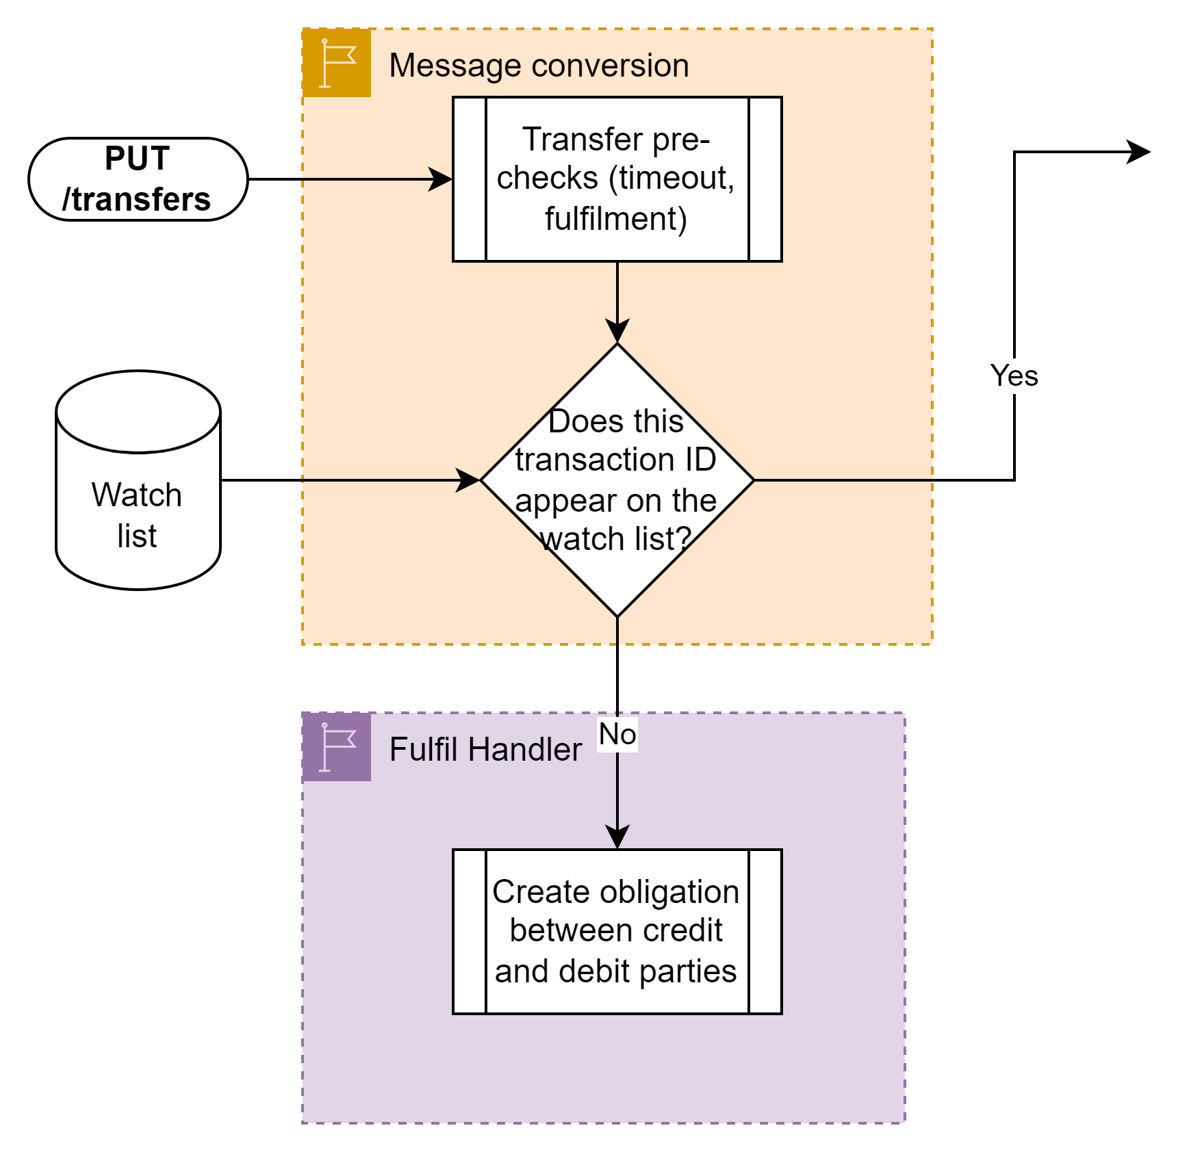
Revised architecture proposal – Fulfil (1)
A PUT transfers is received.
Check to see if there are any watchlist entries for this transaction ID
If not, then this is a standard transfer and can be processed down the existing route.
If yes, transfer to the FX handler.

Slide 10
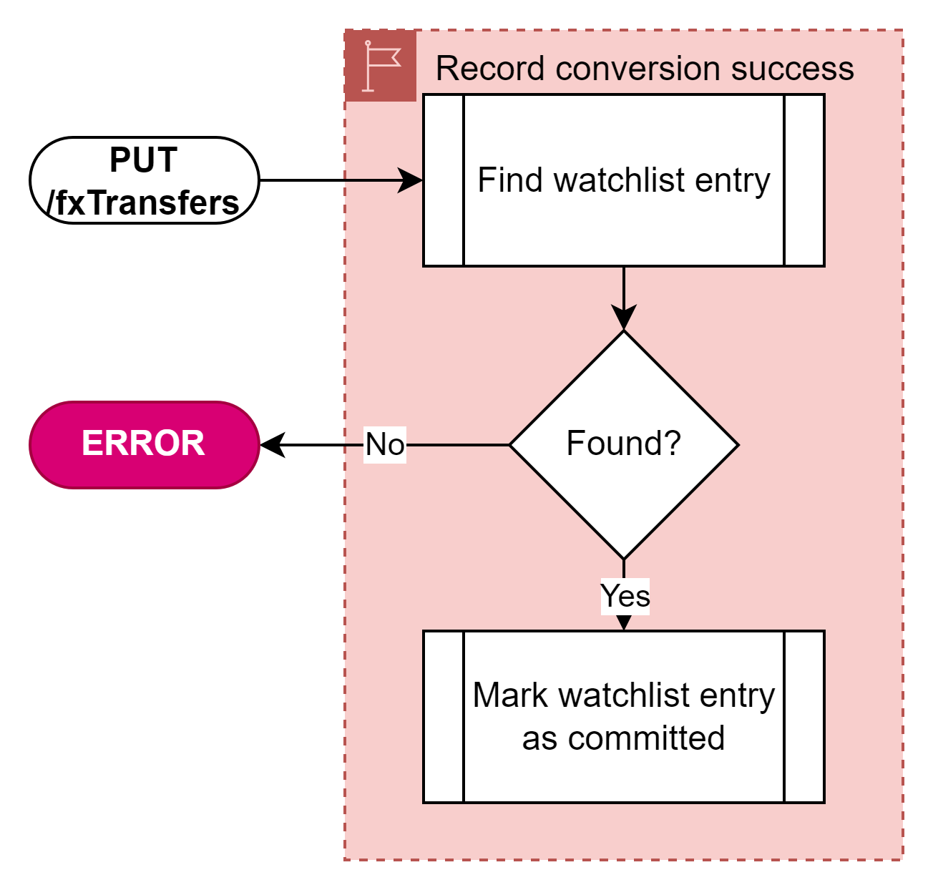
Revised architecture proposal – Fulfil (2)
A PUT /fxTransfers is received.
Check that the status is RESERVED
If not, cancel the transfer.
If so, find the watchlist entry for this FX Transfer
If not found, cancel the transfer
Mark the watchlist entry as committed

Slide 11
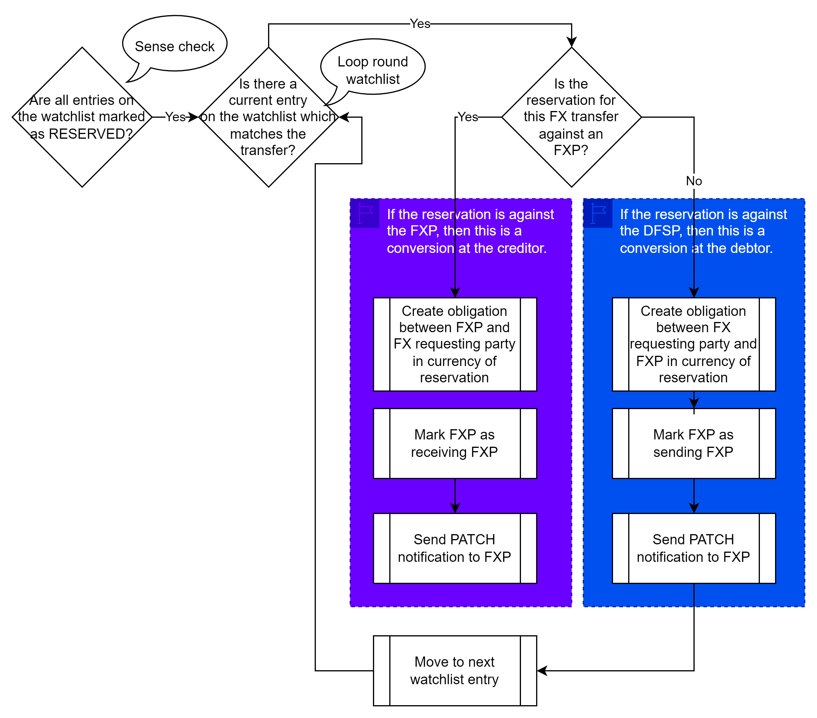
Revised architecture proposal – Fulfil (3)
A PUT /transfers is received for a transfer with currency conversion.
Check that all watchlist entries have completed.
If not, cancel the transfer.
Loop round each conversion entry on the watchlist:
If the reservation for this FX transfer was against the FXP, then this is a conversion by the creditor.
Create an obligation between the FXP and the requesting party in the currency of the reservation
Mark this FXP as the receiving FXP
Send a PATCH notification to the FXP
Otherwise, this is a conversion by the debtor
Create an obligation between the requesting party and the FXP in the currency of the reservation
Mark this FXP as the sending FXP
Send a PATCH notification to the FXP

Slide 12
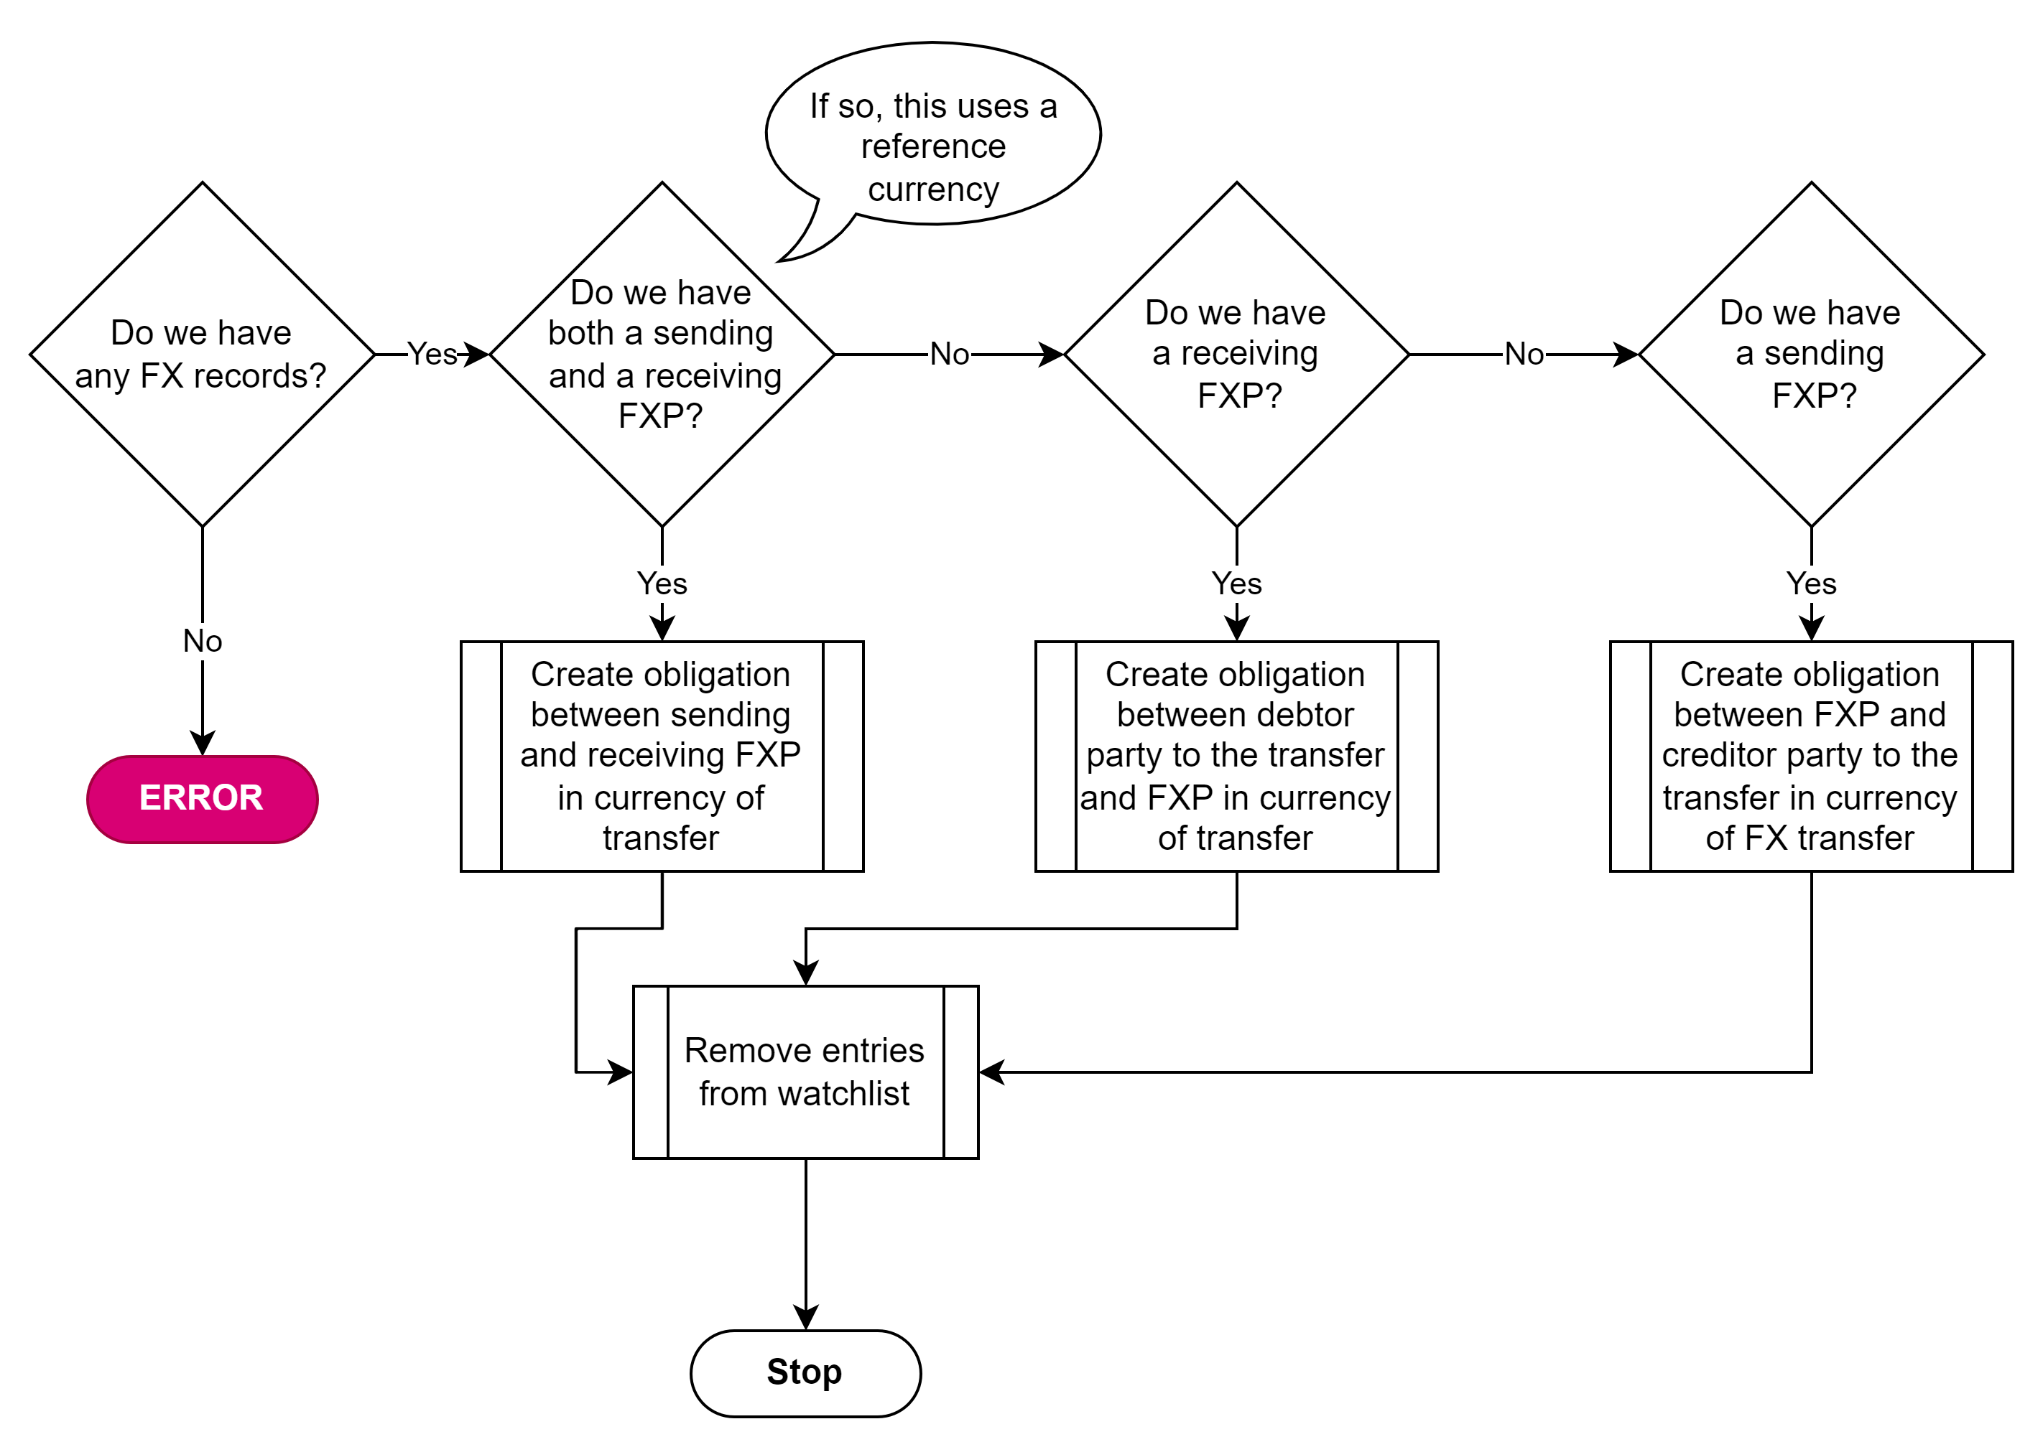
Revised architecture proposal – Fulfil (4)
A PUT /transfers is received for a transfer with currency conversion.
If we have a sending and a receiving FXP, this is a transfer which uses a reference currency
Create an obligation between the sending and receiving FXP in the currency of the transfer
If we have a receiving FXP, this is a transfer where conversion was carried out by the creditor
Create an obligation between the debtor party to the transfer and the receiving FXP in the currency of the transfer
If we have a sending FXP, this is a transfer where conversion was carried out by the debtor
Create an obligation between the sending FXP and the creditor party to the transfer in the currency of the transfer
Remove the entries from the watchlist.

Slide 13
Project roles

Slide 14
Proposed roles
Product owner – Michael Richards
Program manager
Engineering manager
Lead architect
Story creation

Slide 15
Next steps

Slide 16
Objectives
An initial set of epics and stories
… to a level of detail sufficient for time to be estimated and for development to start
… by Friday September 15th.
Story definition meeting proposed for Tuesday 12th, 08:00 – 10:00 UTC

Slide 17
AOB and questions

